Slide 1
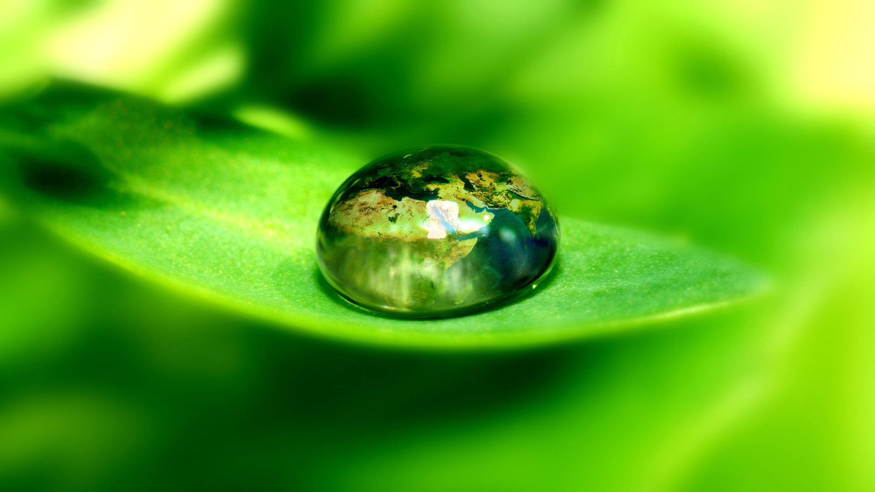
AFRIPLEX
Green Rooibos Extract
And
Cardiovascular Health
Notes:
Good Morning, Ladies and Gentlemen *NEXT*. My name is Sybrand Smit, and I would like to present to you parts of my PhD research, titled Afriplex Green Rooibos Extract and Post-Ischemic Heart Recovery in Diet-Induced, Pre-diabetic Rats. My study is promoted by Prof. Barbara Huisamen and Dr. Erna Marais from Stellenbosch University, and co-promoted by Dr. Rabia Johnson of the South African Medical Research Council, and currently funded in part by the South African National Research Foundation and the Harry Crossley Foundation.

Slide 2
Notes:
Good Morning, Ladies and Gentlemen *NEXT*. My name is Sybrand Smit, and I would like to present to you parts of my PhD research, titled Afriplex Green Rooibos Extract and Post-Ischemic Heart Recovery in Diet-Induced, Pre-diabetic Rats. My study is promoted by Prof. Barbara Huisamen and Dr. Erna Marais from Stellenbosch University, and co-promoted by Dr. Rabia Johnson of the South African Medical Research Council, and currently funded in part by the South African National Research Foundation and the Harry Crossley Foundation.

Slide 3





Afriplex Green Rooibos Extract and Post-Ischemic Heart Recovery in Diet-Induced, Pre-Diabetic Rats
Sybrand E. Smit
3rd Year PhD
27 August 2018
Promoters:
Prof. Barbara Huisamen
Dr. Erna Marais
Dr. Rabia Johnson
Notes:
Good Morning, Ladies and Gentlemen *NEXT*. My name is Sybrand Smit, and I would like to present to you parts of my PhD research, titled Afriplex Green Rooibos Extract and Post-Ischemic Heart Recovery in Diet-Induced, Pre-diabetic Rats. My study is promoted by Prof. Barbara Huisamen and Dr. Erna Marais from Stellenbosch University, and co-promoted by Dr. Rabia Johnson of the South African Medical Research Council, and currently funded in part by the South African National Research Foundation and the Harry Crossley Foundation.

Slide 4


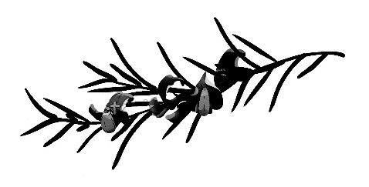
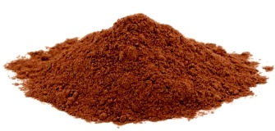
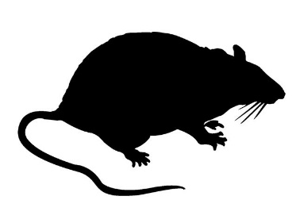
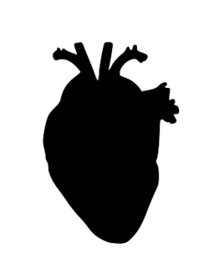

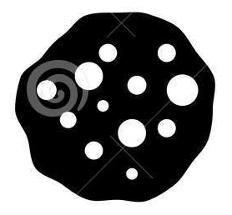

Outline of Proposal
Condition
Cardiovascular Diseases
Obesity, Insulin Resistance, Diabetes
Treatment
Herbal Supplements
AFRIPLEX Green Rooibos Extract
Experimental Procedure
Aims
Animal Models and Techniques
Results
2018
Notes:
In this talk I will be *CLICK* discussing the growing problem of cardiovascular diseases worldwide, as well as the contributing factors which causes CVD’s to be so prevalent. *CLICK*
Secondly, I want to share a bit more about Rooibos, the manufacturing of Afriplex Green Rooibos Extract and its rationale as a cardioprotective herbal supplement.
Third *CLICK*, I’ll elaborate more on the specific aims of my research, the animal models and techniques we used.
From there *CLICK* I’ll demonstrate some of the findings of my study to date and then *CLICK* I’ll finish of with our hope for end of this year and the questions that still need answers.

Slide 5
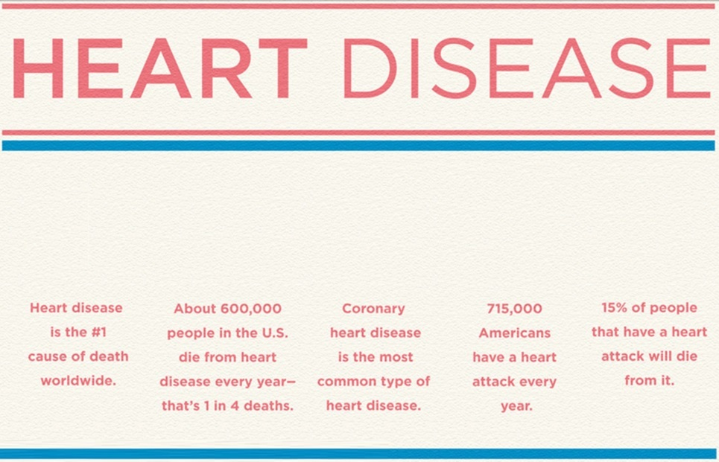
Cardiovascular disease is the #1 cause of death worldwide
Notes:
So firstly, why is it important for us to endeavour into cardioprotective research? Well *CLICK*, Cardiovascular Diseases remains the Nr. 1 cause of death worldwide, *CLICKS* totalling an estimated 17.5 million deaths in 2012, which is representative of 31% of all global deaths. This mortality count can be further divided *CLICK* into 7.4 million deaths due to coronary heart disease, and 6.7 million deaths due to strokes, which is the collective cause of death in about 80% of cardiovascular disease deaths.

Slide 6
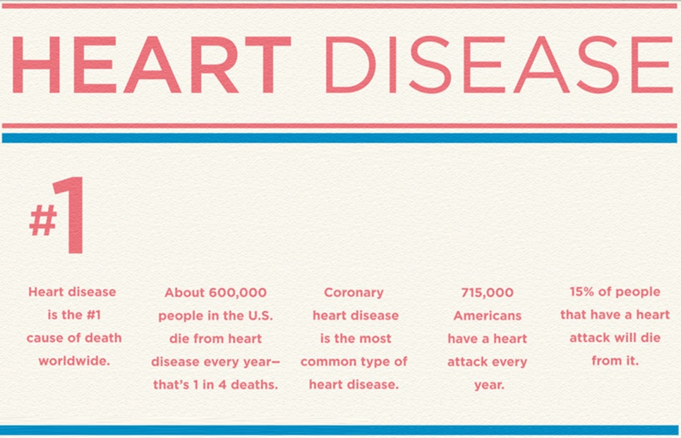
Cardiovascular disease is the #1 cause of death worldwide
Notes:
So firstly, why is it important for us to endeavour into cardioprotective research? Well *CLICK*, Cardiovascular Diseases remains the Nr. 1 cause of death worldwide, *CLICKS* totalling an estimated 17.5 million deaths in 2012, which is representative of 31% of all global deaths. This mortality count can be further divided *CLICK* into 7.4 million deaths due to coronary heart disease, and 6.7 million deaths due to strokes, which is the collective cause of death in about 80% of cardiovascular disease deaths.

Slide 7
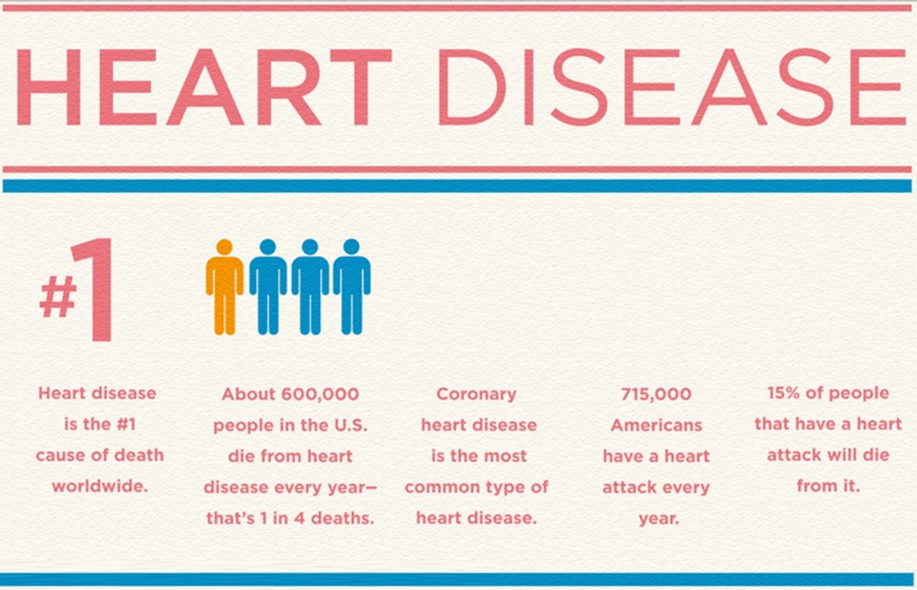
Cardiovascular disease is the #1 cause of death worldwide
17.5 million people die globally from CVD every year – that’s 1 in 3 deaths
Notes:
So firstly, why is it important for us to endeavour into cardioprotective research? Well *CLICK*, Cardiovascular Diseases remains the Nr. 1 cause of death worldwide, *CLICKS* totalling an estimated 17.5 million deaths in 2012, which is representative of 31% of all global deaths. This mortality count can be further divided *CLICK* into 7.4 million deaths due to coronary heart disease, and 6.7 million deaths due to strokes, which is the collective cause of death in about 80% of cardiovascular disease deaths.

Slide 8
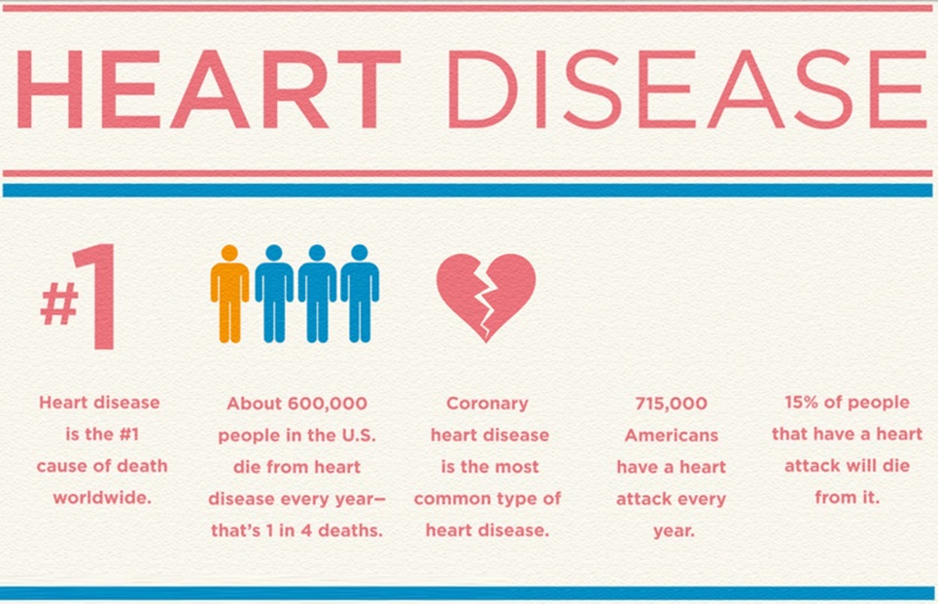
Cardiovascular disease is the #1 cause of death worldwide
17.5 million people die globally from CVD every year – that’s 1 in 3 deaths
Coronary heart disease and strokes account for 80% of CVD mortalities
Notes:
So firstly, why is it important for us to endeavour into cardioprotective research? Well *CLICK*, Cardiovascular Diseases remains the Nr. 1 cause of death worldwide, *CLICKS* totalling an estimated 17.5 million deaths in 2012, which is representative of 31% of all global deaths. This mortality count can be further divided *CLICK* into 7.4 million deaths due to coronary heart disease, and 6.7 million deaths due to strokes, which is the collective cause of death in about 80% of cardiovascular disease deaths.
Furthermore, *CLICK*

Slide 9
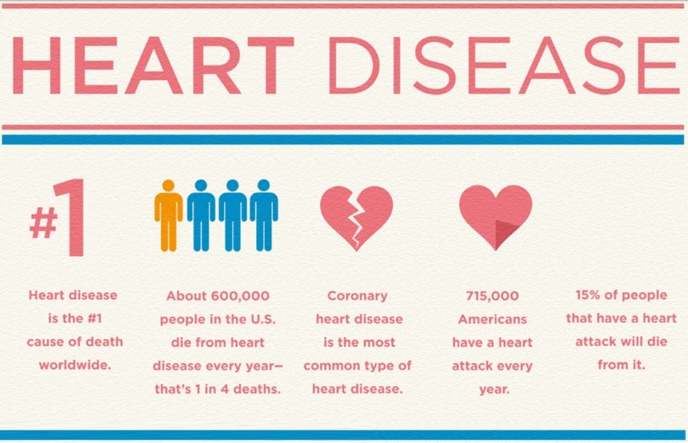
Cardiovascular disease is the #1 cause of death worldwide
17.5 million people die globally from CVD every year – that’s 1 in 3 deaths
Coronary heart disease and strokes account for 80% of CVD mortalities
15% of people suffering a heart attack will die
Notes:
Furthermore, *CLICK* without hospitalization, or professional intervention, 15% of people who suffer a heart attack die, and *CLICK* diabetics have a further 4 times higher chance of dying from a heart attack.
However, reaching the point where you become one of these statistics do not just happen.

Slide 10
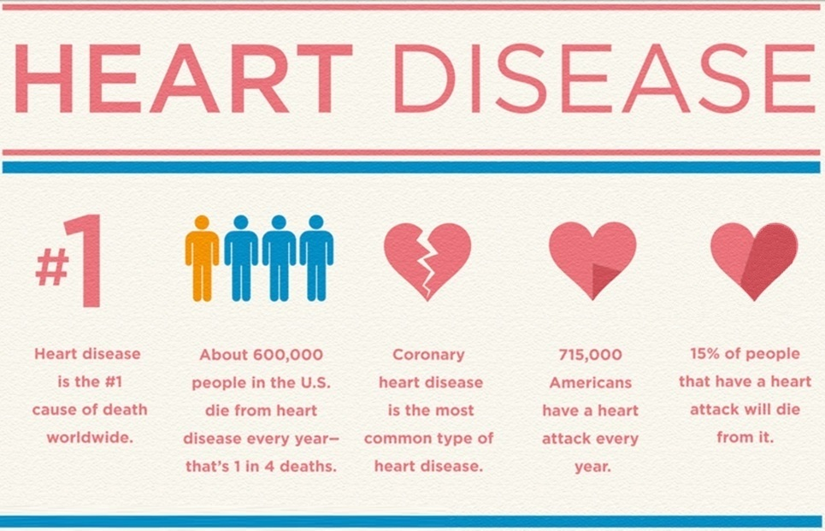
Cardiovascular disease is the #1 cause of death worldwide
17.5 million people die globally from CVD every year – that’s 1 in 3 deaths
Coronary heart disease and strokes account for 80% of CVD mortalities
15% of people suffering a heart attack will die
Diabetes increases risk of heart attack death upto 4X
Notes:
Furthermore, *CLICK* without hospitalization, or professional intervention, 15% of people who suffer a heart attack die, and *CLICK* diabetics have a further 4 times higher chance of dying from a heart attack.
However, reaching the point where you become one of these statistics do not just happen.

Slide 11
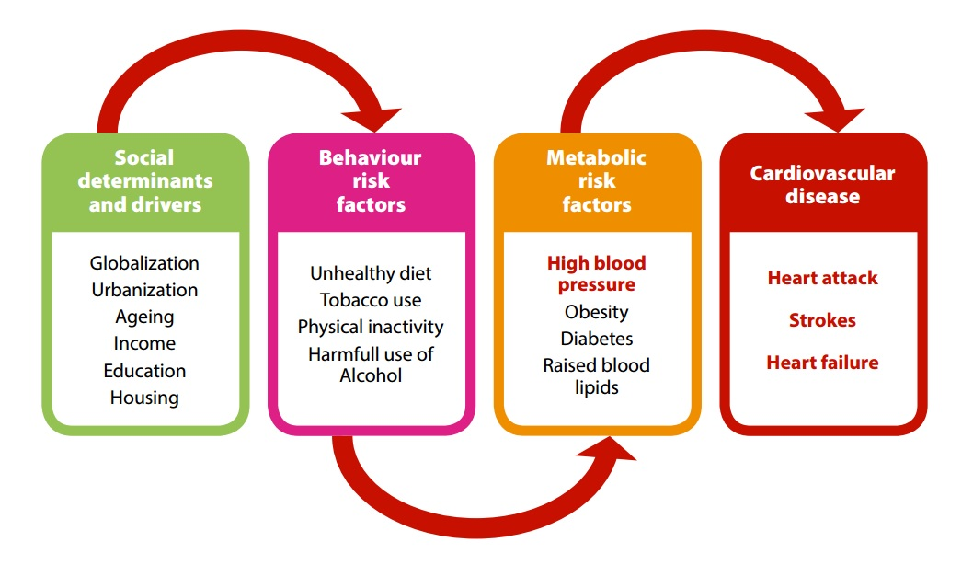
Notes:
Luckily, it’s a process with various opportunities for intervention AND Identifying risk factors and taking the necessary steps to resolve them are key to improving your health. And this also enables us as researchers to find novel ways to treat the metabolic risk factors and symptoms which may give rise to cardiovascular diseases.

Slide 12
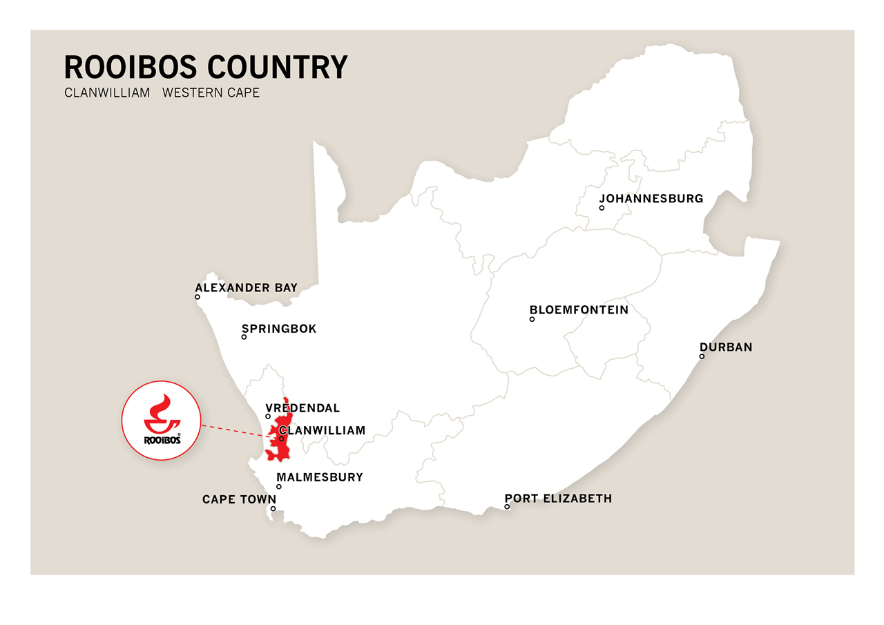
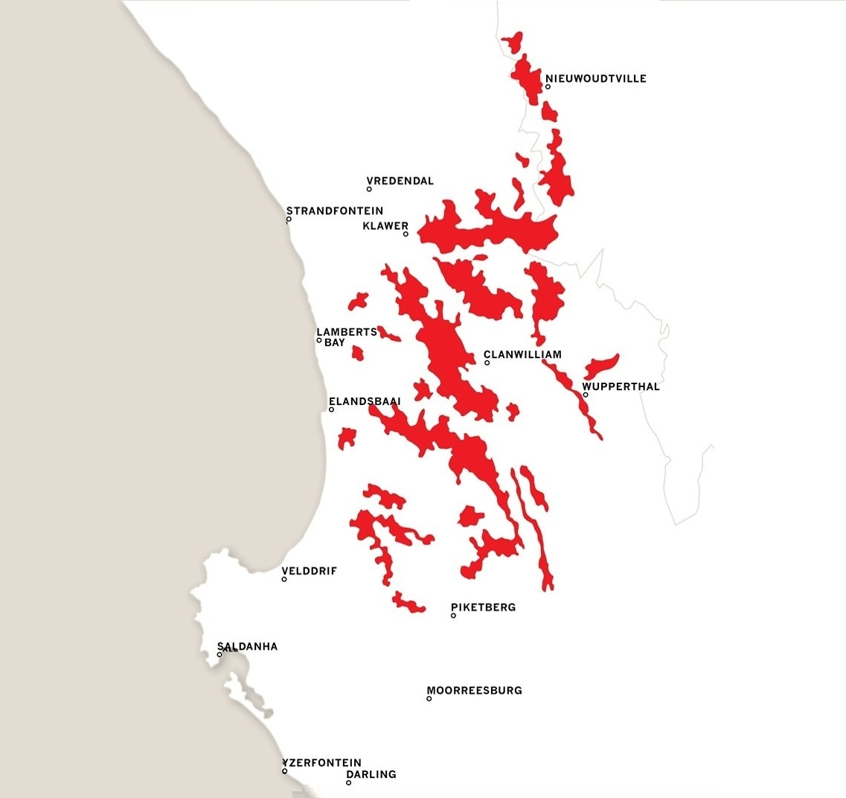
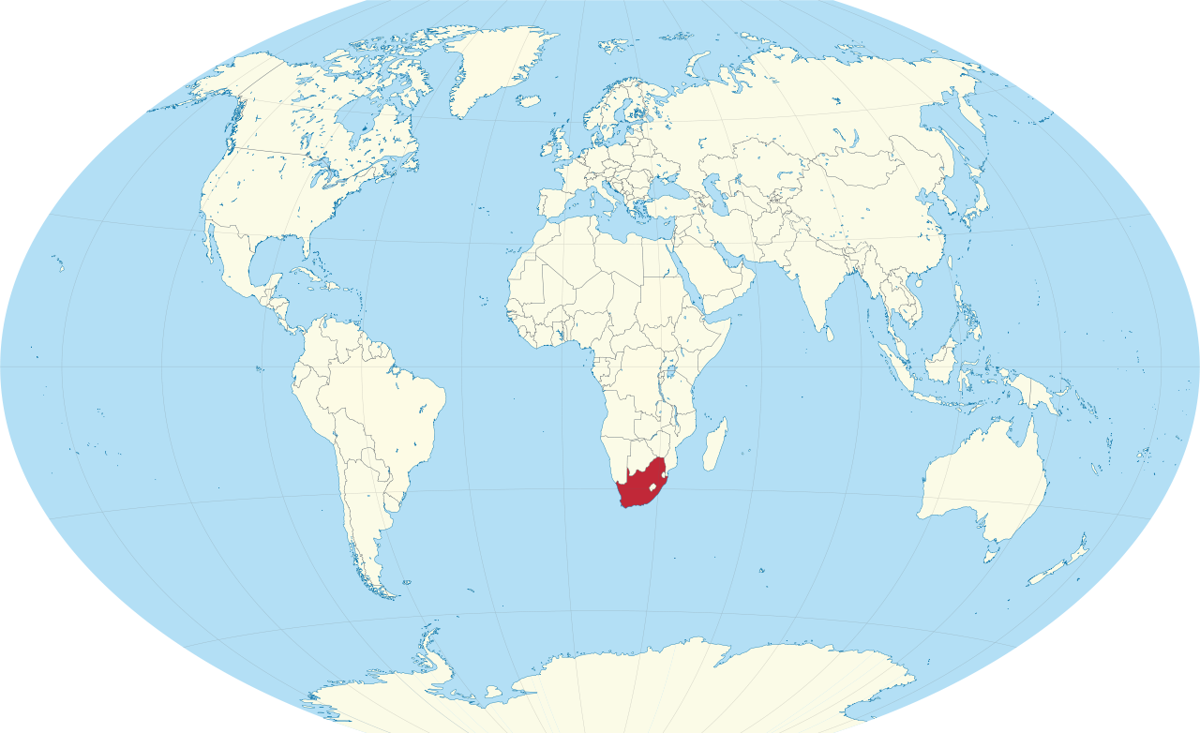
Rooibos
(Aspalathin Linearis)
South Africa
Notes:
Thus, in ‘ever’ search of new and improved treatments to help prevent and treat cardiovascular diseases, we draw our attention to a South African plant called *CLICK* Rooibos (or Aspalathin Linearis), which is indigenous to the Western Cape Region, *CLICK* and coincidentally grown all around my home town *CLICK*, Lambert’s Bay – so, if you ever find yourself in this part of the world, please feel free to contact me for some tips on how to properly enjoy Rooibos OR some Crayfish, Black Mussels and Snoek. But we can talk about that later… *CLICK*

Slide 13
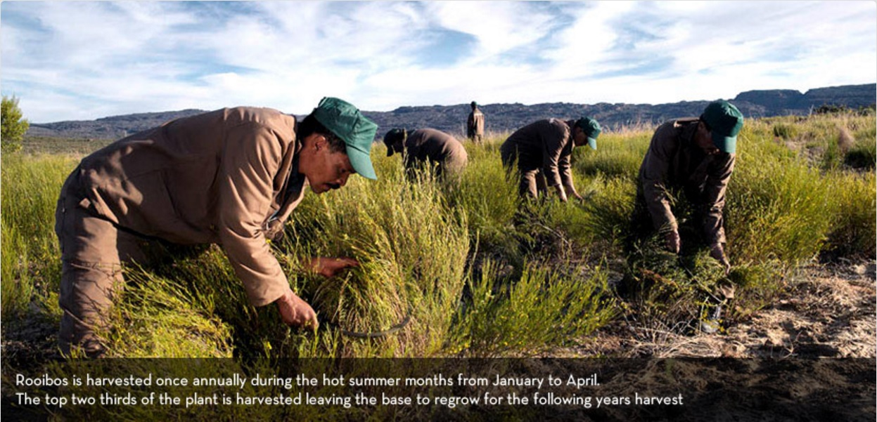
Notes:
But moving on, Rooibos is harvested annually during the hot South African summer time of January to April *CLICK*, whereby about two thirds of the plant is sickled off and the rest left to regrow for the following year *CLICK* while the shrubs are then transported to *CLICK* a processing facility. Now, importantly, *CLICK*

Slide 14
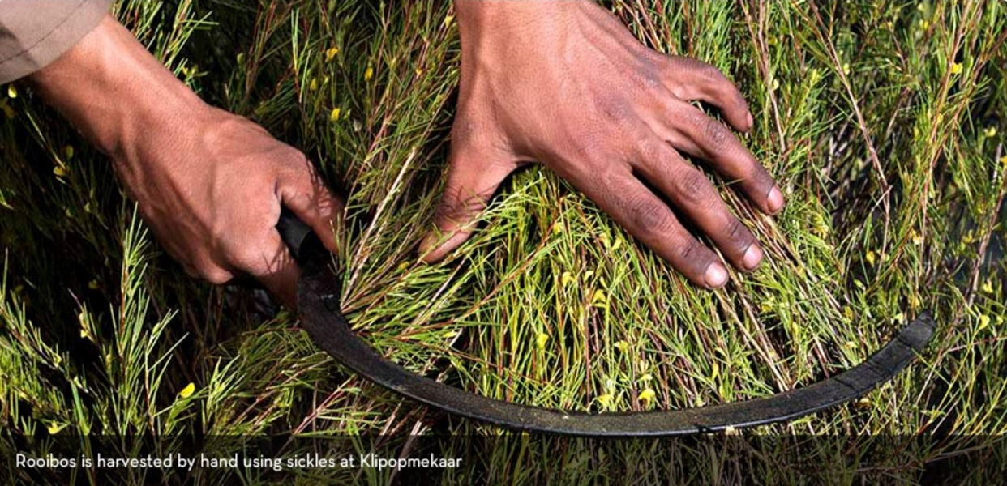
Notes:
But moving on, Rooibos is harvested annually during the hot South African summer time of January to April *CLICK*, whereby about two thirds of the plant is sickled off and the rest left to regrow for the following year *CLICK* while the shrubs are then transported to *CLICK* a processing facility. Now, importantly, *CLICK*

Slide 15
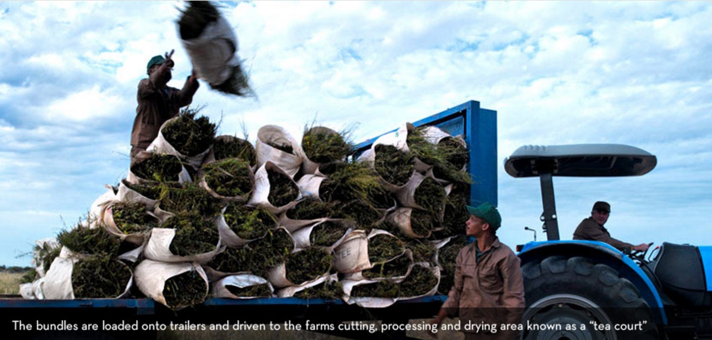
Notes:
But moving on, Rooibos is harvested annually during the hot South African summer time of January to April *CLICK*, whereby about two thirds of the plant is sickled off and the rest left to regrow for the following year *CLICK* while the shrubs are then transported to *CLICK* a processing facility. Now, importantly, *CLICK*

Slide 16
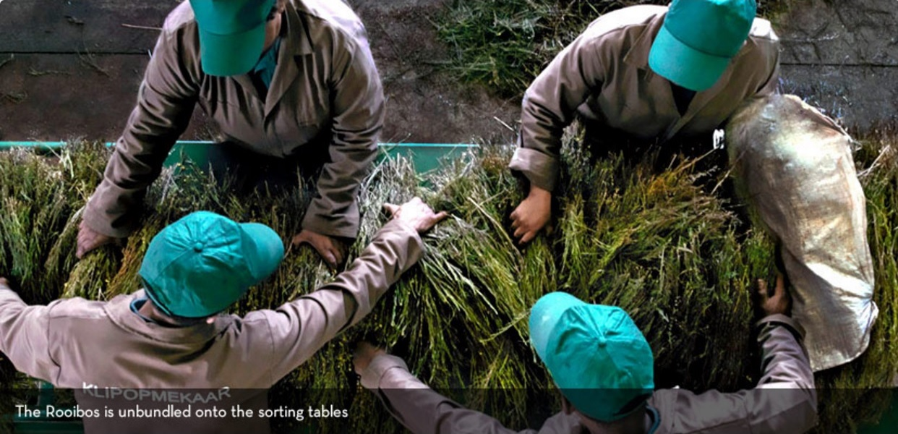
Notes:
But moving on, Rooibos is harvested annually during the hot South African summer time of January to April *CLICK*, whereby about two thirds of the plant is sickled off and the rest left to regrow for the following year *CLICK* while the shrubs are then transported to *CLICK* a processing facility. Now, importantly, *CLICK*

Slide 17
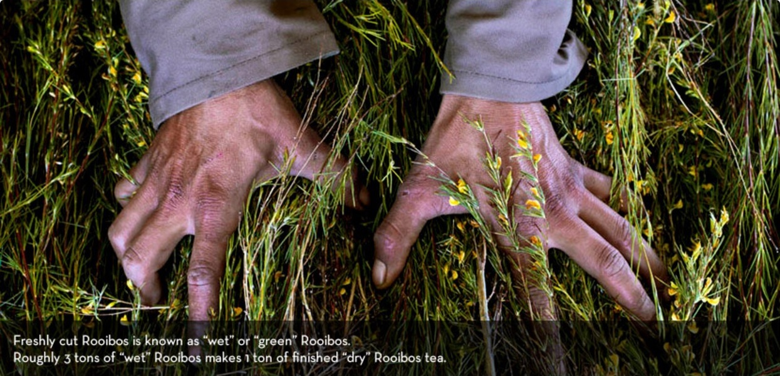
Notes:
Freshly cut rooibos is known as *CLICK* “WET” or “GREEN” rooibos, which is the basis of the Afriplex GRT product used in our research. This is opposed *CLICK* to the fermented rooibos (or sundried rooibos), which is the more popular form of *CLICK* rooibos usually consumed as a tea. The difference being, the fermentation process *CLICK*

Slide 18
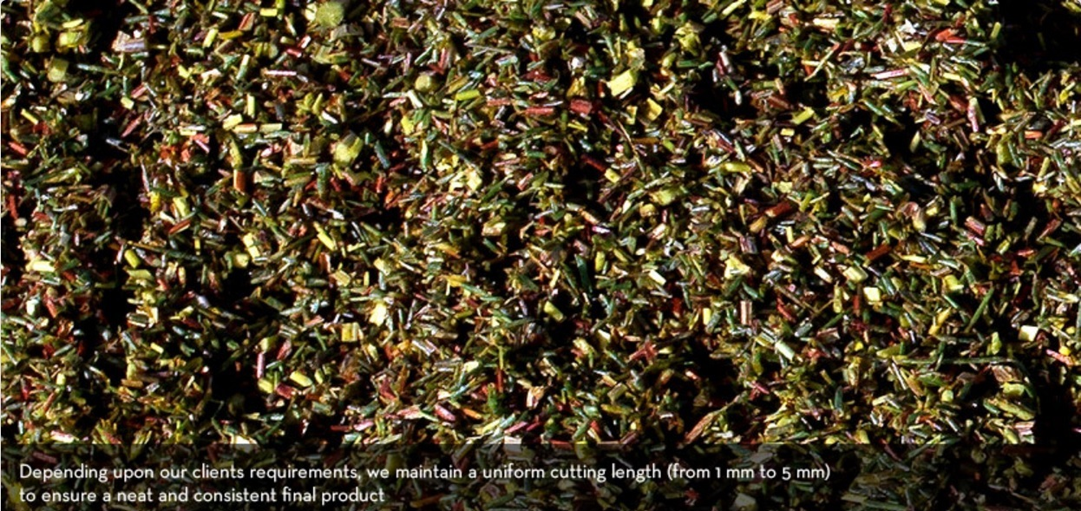
Notes:
Freshly cut rooibos is known as *CLICK* “WET” or “GREEN” rooibos, which is the basis of the Afriplex GRT product used in our research. This is opposed *CLICK* to the fermented rooibos (or sundried rooibos), which is the more popular form of *CLICK* rooibos usually consumed as a tea. The difference being, the fermentation process *CLICK*

Slide 19
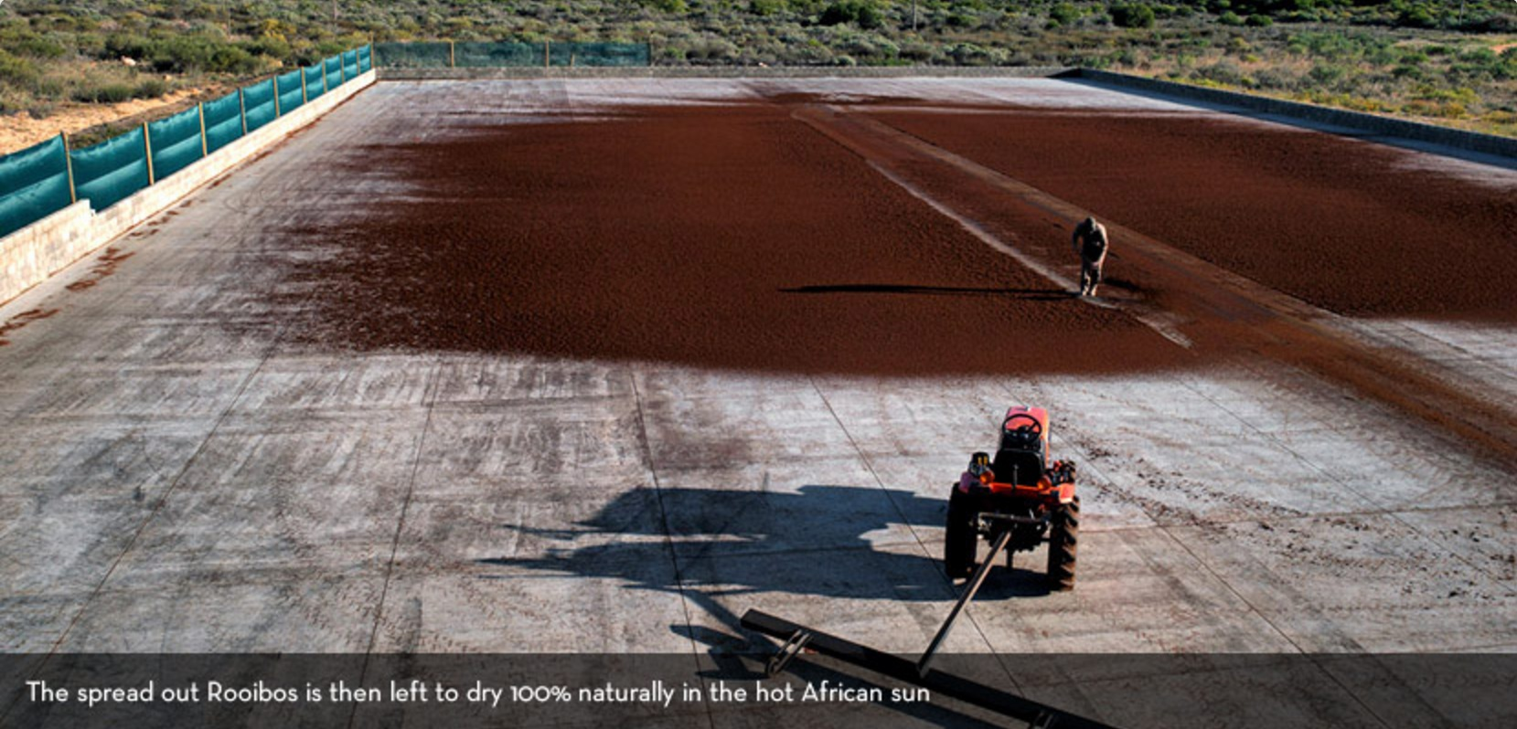
Notes:
Freshly cut rooibos is known as *CLICK* “WET” or “GREEN” rooibos, which is the basis of the Afriplex GRT product used in our research. This is opposed *CLICK* to the fermented rooibos (or sundried rooibos), which is the more popular form of *CLICK* rooibos usually consumed as a tea. The difference being, the fermentation process *CLICK*

Slide 20
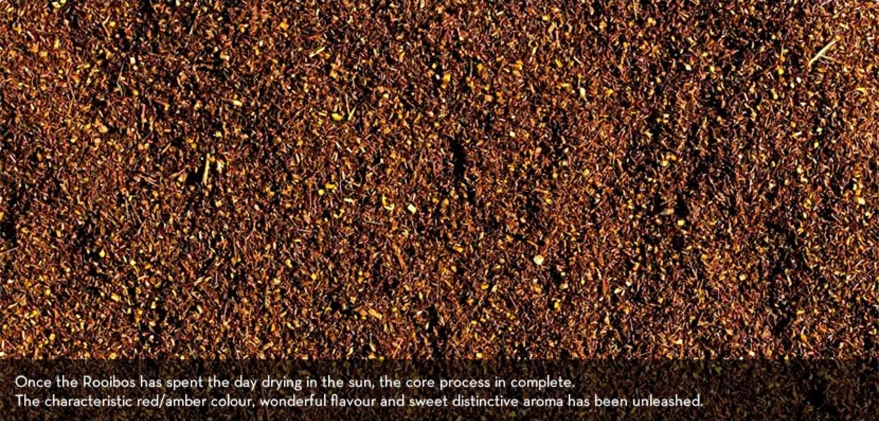
Notes:
Freshly cut rooibos is known as *CLICK* “WET” or “GREEN” rooibos, which is the basis of the Afriplex GRT product used in our research. This is opposed *CLICK* to the fermented rooibos (or sundried rooibos), which is the more popular form of *CLICK* rooibos usually consumed as a tea. The difference being, *CLICK*

Slide 21
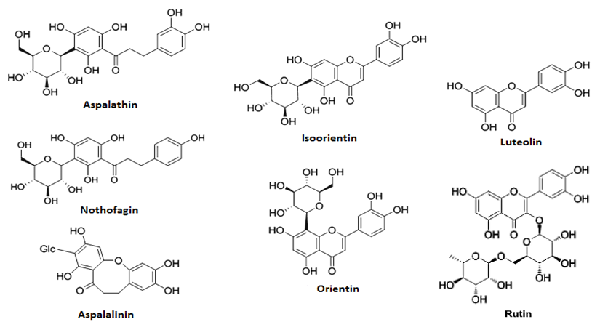
Major Compounds in Rooibos
↓ 85%
↓ 25%
↓ 85%
↓ 25%
↓ 30%
Notes:
the fermentation process is severely detrimental to the polyphenolic content of rooibos, and as a result decreases its therapeutic potential. Therefore, Afriplex developed a method *CLICK* to first extract polyphenols from Green Rooibos with alcohol and then spray drying the solution to obtain powdered extract, with Aspalathin yields as high as 15%.

Slide 22
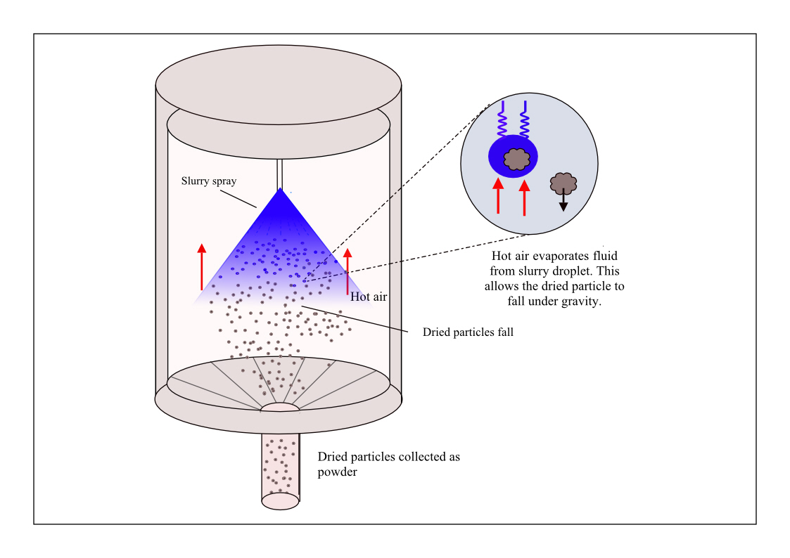

Afriplex
Green Rooibos Extract
Notes:
the fermentation process is severely detrimental to the polyphenolic content of rooibos, and as a result decreases its therapeutic potential. Therefore, Afriplex developed a method *CLICK* to first extract polyphenols from Green Rooibos with alcohol and then spray drying the solution to obtain powdered extract, with Aspalathin yields as high as 15%.

Slide 23
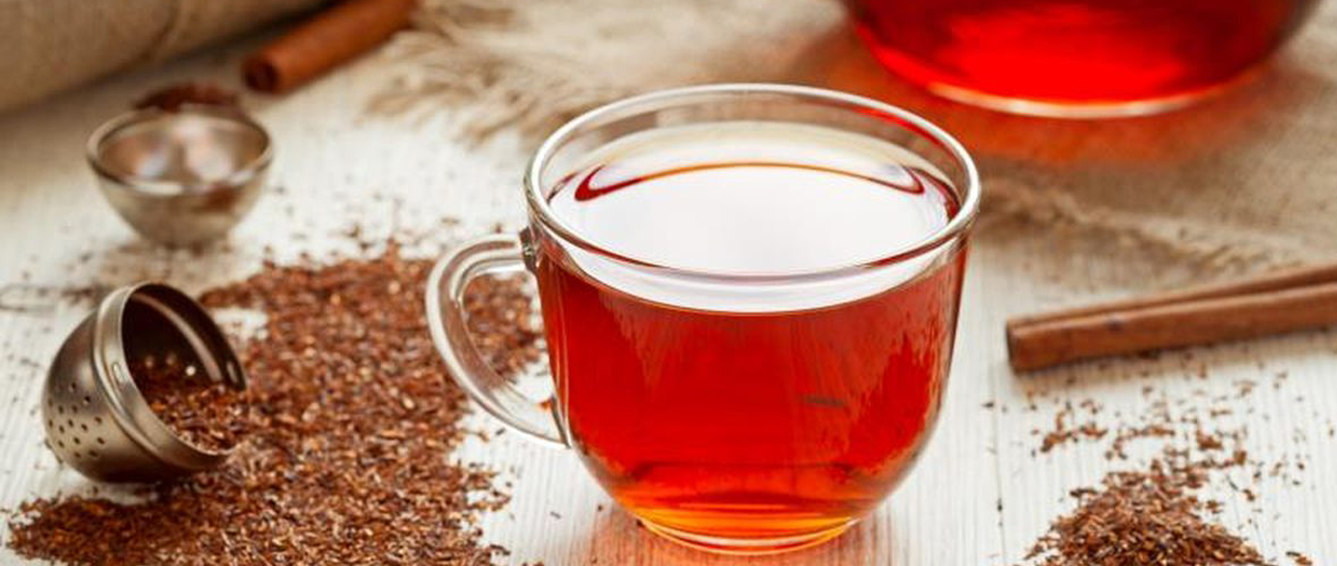
Why Rooibos?
Notes:
So, what is the rationale for rooibos’ cardioprotective potential?

Slide 24
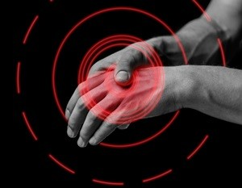

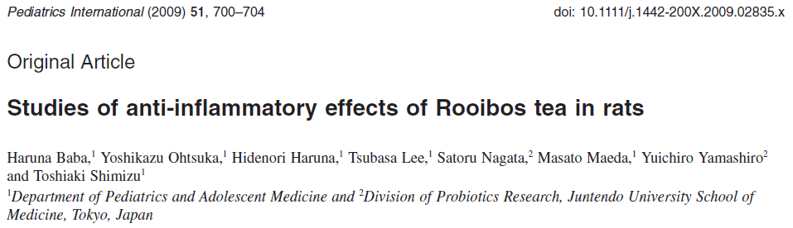
Anti-
Inflammatory
Anti-inflammatory
Notes:
Well, Rooibos has shown to elicit various cardioameliorative responses in cells, animals and human studies to date. First of all, Rooibos is rich in polyphenols such as aspalathin and nothofagin, which are strong antioxidants. *CLICK* These polyphenols also have anti-inflammatory properties which can strengthen the body’s immune system and prevent heart related illnesses.

Slide 25
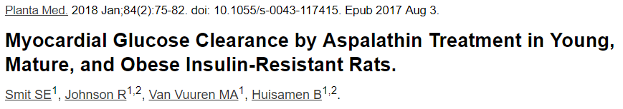
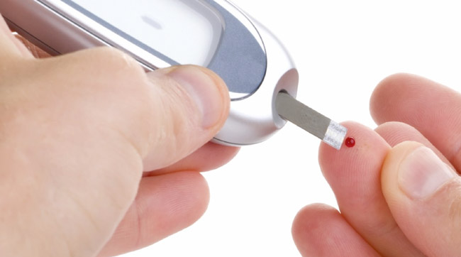
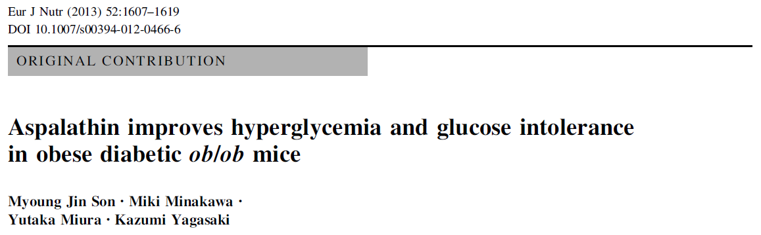
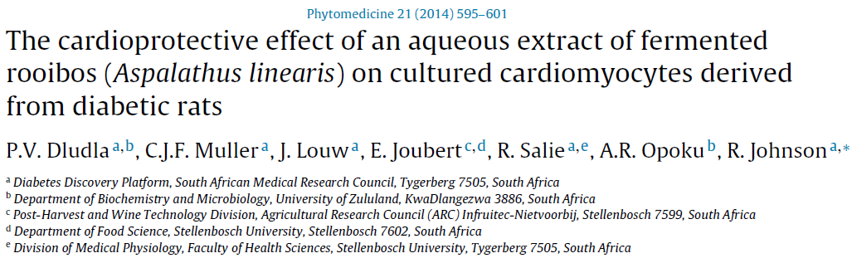
Hypoglycemic Agent
Notes:
Rooibos extracts and aspalathin has been shown to *CLICK* have a hypoglycemic effect in the body and *CLICK* improve insulin resistance. It promotes glucose absorption in skeletal muscles, and in previous *CLICK* work done in our labs we also found that purified aspalathin is capable of improving glucose uptake in cardiomyocytes.

Slide 26
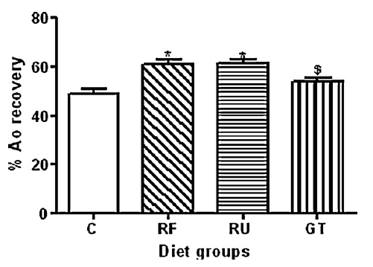
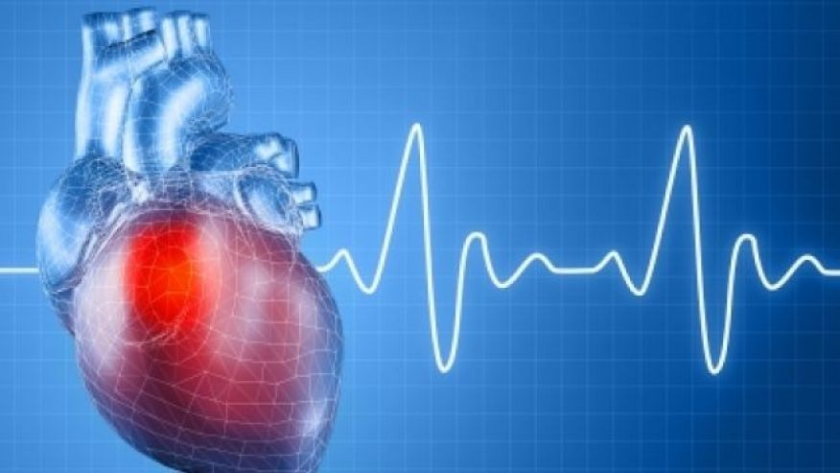
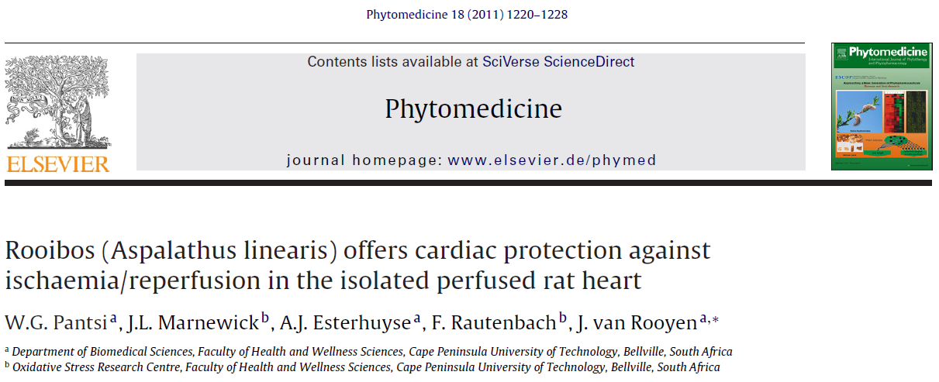
Improved Heart Function
Notes:
Rooibos has also been shown to improve heart function after an ischemic event, as was demonstrated *CLICK* by Pantsi et al. (2011). Rats receiving rooibos supplementation *CLICK* had a significantly improved aortic output recovery post ischemia compared to both control rats and rats receiving Green Tea.

Slide 27
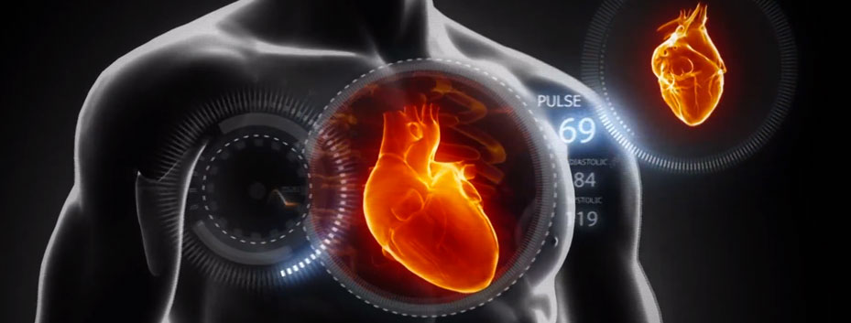
Methodology
Notes:
Good, this brings me to our research.

Slide 28
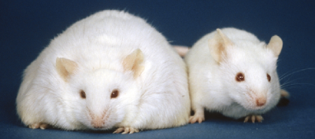
WISTAR RAT MODEL
HCD Rats (Obese and Insulin-Resistant Rats)
16 Week High-Caloric Diet
Control Rats (Age-matched to HCD Rats)
16 Week Normal Rat Chow
 | Fat (g/100g) | Cholesterol (mg/100g) | Protein (%) | CHO (%) | Sugar (g/100g) | Energy (kJ/100g)
Control | 4.8 | 3 | 17.1 | 34.6 | 6.6 | 1272
High-Fat, High Caloric Diet | 11.5 | 13 | 8.3 | 42 | 24.4 | 1354
Notes:
In order to induce cardiovascular risk, I made use of a Wistar rat model of diet-induced obesity and Insulin resistance.

Slide 29
Notes:
Increasing the behavioural and metabolic risk factors of these animals, increases the susceptibility for cardiovascular disease and mimics the human condition in patients suffering from CVD. We do this by firstly subjecting young 6 week-old rats, *CLICK* to a 16-week unhealthy diet (essentially giving them lots of condensed milk, sugar and holsum cooking fat). From previous experience, *CLICK* we know that this model presents with obesity, raised blood lipids, and approach pre-diabetes by displaying full body and cardial insulin resistance and hyperglycemia.

Slide 30
Notes:
The idea is to compare the function of a normal heart to that of a gradually failing heart induced by increased risk factors through high-sucrose feeding. When these hearts are subjected to an ischemic event, the level of functional recovery is also significantly worst. Therefore, supplementing with Afriplex GRT whilst the animals are still on diet enable us to investigate GRT’s capacity to instil cardioprotection.

Slide 31
Notes:
The idea is to compare the function of a normal heart to that of a gradually failing heart induced by increased risk factors through high-sucrose feeding. When these hearts are subjected to an ischemic event, the level of functional recovery is also significantly worst. Therefore, supplementing with Afriplex GRT whilst the animals are still on diet enable us to investigate GRT’s capacity to instil cardioprotection.

Slide 32
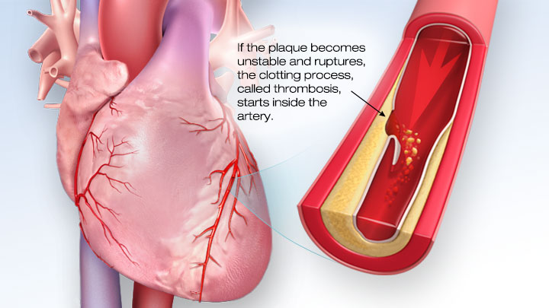
Notes:
The idea is to compare the function of a normal heart to that of a gradually failing heart induced by increased risk factors through high-sucrose feeding. When these hearts are subjected to an ischemic event, the level of functional recovery is also significantly worst. Therefore, supplementing with Afriplex GRT whilst the animals are still on diet enable us to investigate GRT’s capacity to instil cardioprotection.

Slide 33
Notes:
The idea is to compare the function of a normal heart to that of a gradually failing heart induced by increased risk factors through high-sucrose feeding. When these hearts are subjected to an ischemic event, the level of functional recovery is also significantly worst. Therefore, supplementing with Afriplex GRT whilst the animals are still on diet enable us to investigate GRT’s capacity to instil cardioprotection.

Slide 34
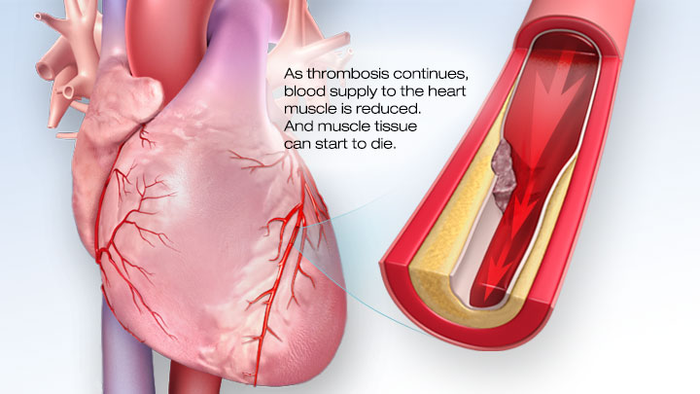
Notes:
The idea is to compare the function of a normal heart to that of a gradually failing heart induced by increased risk factors through high-sucrose feeding. When these hearts are subjected to an ischemic event, the level of functional recovery is also significantly worst. Therefore, supplementing with Afriplex GRT whilst the animals are still on diet enable us to investigate GRT’s capacity to instil cardioprotection.

Slide 35
Notes:
The idea is to compare the function of a normal heart to that of a gradually failing heart induced by increased risk factors through high-sucrose feeding. When these hearts are subjected to an ischemic event, the level of functional recovery is also significantly worst. Therefore, supplementing with Afriplex GRT whilst the animals are still on diet enable us to investigate GRT’s capacity to instil cardioprotection.

Slide 36
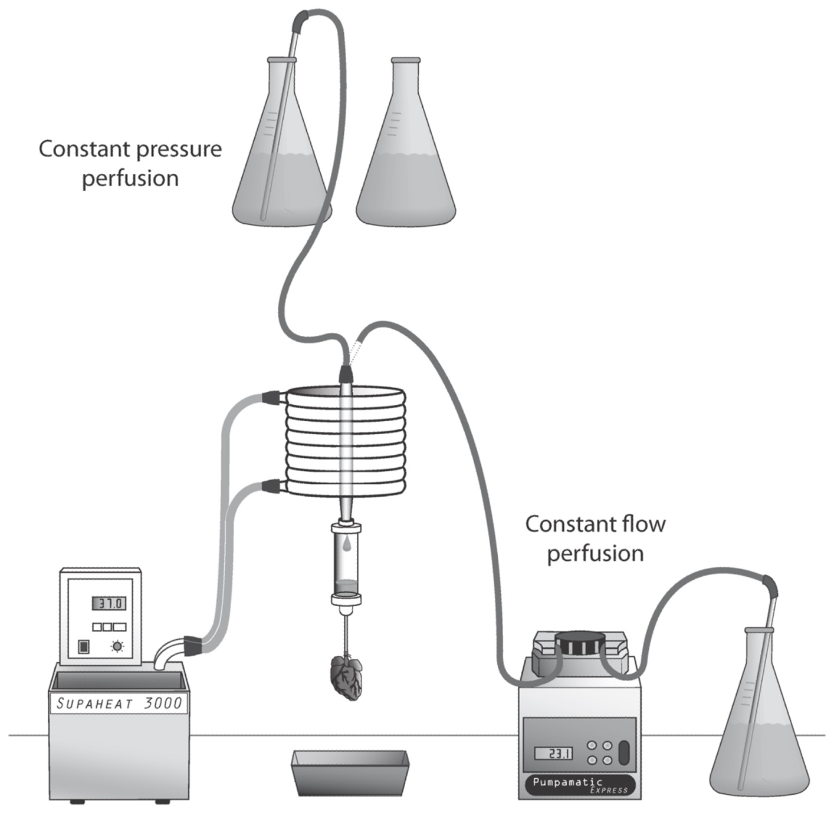
Heart Function
Langendorff
10min
Working Heart
20min
Global Ischemia
Langendorff
20min
10min
Working Heart
20min
Aortic Systolic + Diastolic BP
Coronary + Aortic Flow
Functional Recovery
Heart Rate
Reperfusion
Ischemia
Stabilization
Notes:
To simulate this, the protocol is as follow. Just after sedation of the rat, the hearts are quickly excised and mounted on a perfusion rig. For the first 10 minutes the heart is perfused *CLICK* in Langendorff mode, meaning *CLICK* retrogradely through the aorta, which fills the heart chambers and coronary arteries with fresh blood-‘substituting’ buffer. During this period we can measure the coronary flow *CLICK*, which is indicative of how well the heart is nourishing itself. *CLICK*

Slide 37
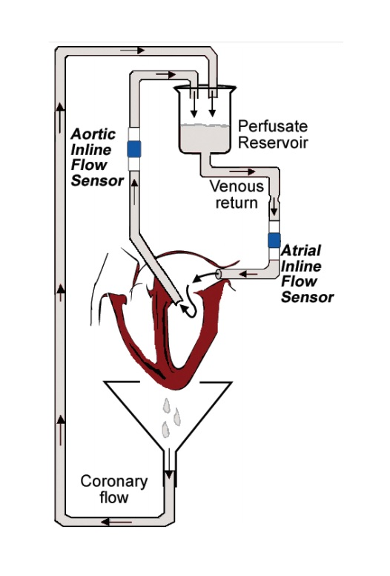
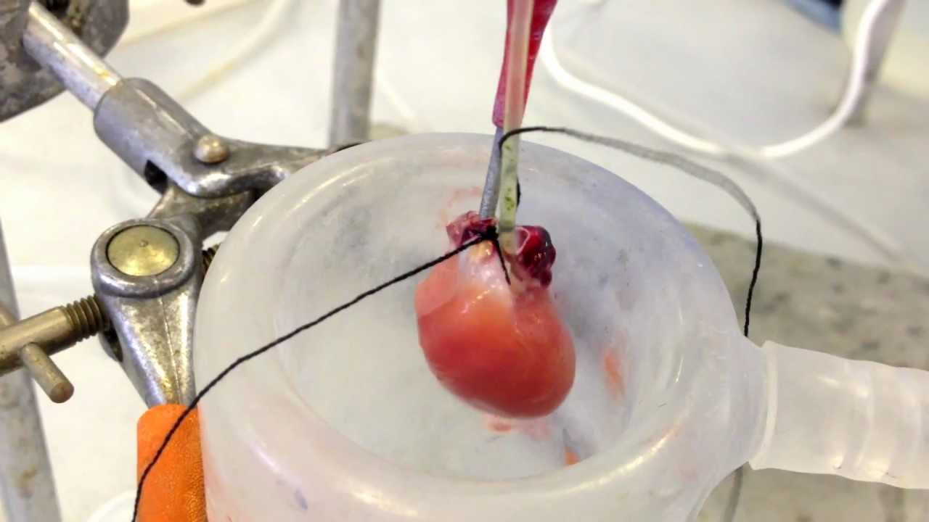
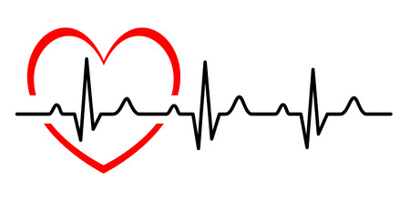
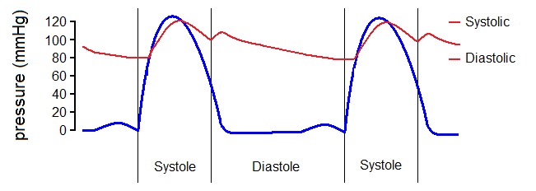
Heart Function
Langendorff
10min
Working Heart
20min
Global Ischemia
Langendorff
10min
Working Heart
20min
20min
Aortic Systolic + Diastolic BP
Coronary + Aortic Flow
Functional Recovery
Heart Rate
Reperfusion
Ischemia
Stabilization
Notes:
This is followed by switching to *CLICK* working heart mode for 20 minutes by inserting a canula into the left atrium. Whilst in working mode, we can measure the amount of *CLICK* heart beats per minute, the *CLICK* systolic and diastolic pressure, and the *CLICK* aortic output, or the volume of blood pumped by the heart every minute *CLICK*. After this stabilization period, the heart is subjected to *CLICK* global ischaemia for 20 mins by simply shutting off all perfusate and oxygen supply to the heart, which is the equivalent of having complete heart failure. *CLICK*

Slide 38
Heart Function
Freeze Clamp
Langendorff
10min
Working Heart
20min
Global Ischemia
Langendorff
20min
10min
Working Heart
20min
Aortic Systolic + Diastolic BP
Coronary + Aortic Flow
Functional Recovery
Heart Rate
Reperfusion
Ischemia
Stabilization
Notes:
The ischemic event is followed by reperfusion (or resuscitation in human terms) by first stabilizing the heart again using Langendorff perfusion, followed by working heart mode. Using this method we are able to compare the function of the heart pre- and post-ischemia to derive how the Rooibos extract effected recovery. At the end of the protocol the heart is removed from the perfusion rig and *CLICK* freeze clamped to be examined later for protein mechanisms.

Slide 39
Wistar Rats (200)
6 Weeks Old
Untreated (50)
GRT (50)
Last 6 Weeks
Untreated (50)
GRT (50)
Last 6 Weeks
Control Rats (100)
16 Weeks Diet
Diet-Induced Obesity (100)
16 Weeks Diet
STUDY
DESIGN
GRT = 60mg/kg Rat/day
Afriplex GRT
Dissolved in 1mL Jelly Cube
= HUMAN EQUIVALENT
70 Cups of Rooibos Tea / DAY
Notes:
So, up until this point of the study I have sacrificed *CLICK* 200 wistar Rats, staggered into *CLICK* 100 control rats receiving only rat chow, of which half received *CLICK* strawberry jelly and the other half a *CLICK* Afriplex Green rooibos extract dissolved in strawberry jelly, and then another *CLICK* 100 rats receiving a high-caloric diet for 16 weeks, of which half again only received *CLICK* normal jelly and the other half *CLICK* AFRIPLEX GRT jelly for the last 6 weeks of the diet *CLICK* at a human equivalent of approximately 70 cups of rooibos tea per day.

Slide 40

Results
1
Notes:
Okay, the results, THUS FAR, are as follows…

Slide 41
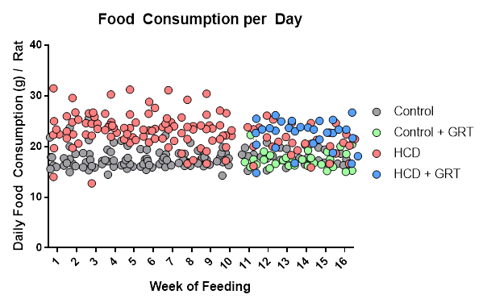
Food Consumption
Notes:
Firstly, in establishing the animal model we noted that the HCD animals consistently ate more food than the control counterparts, regardless of GRT supplementation, meaning the rooibos extract did not have an influence on appetite.

Slide 42
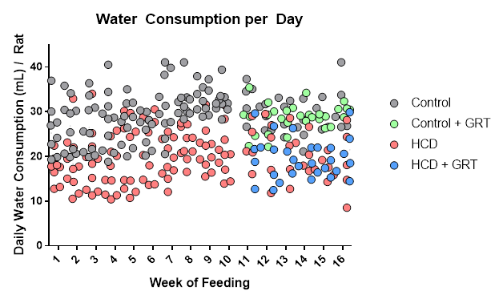
Water Consumption
Notes:
Likewise, the High caloric diet rats also consumed less water than the controls, regardless of GRT supplementation, also inferring that rooibos extract did not significantly influence thirst in these rats.

Slide 43
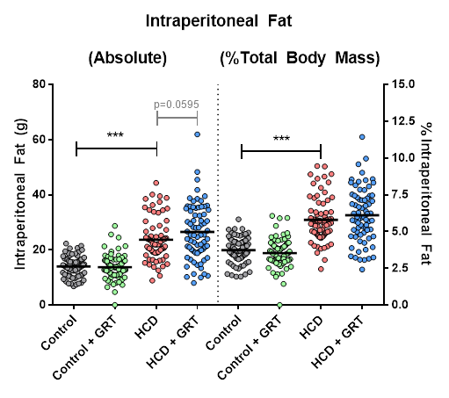
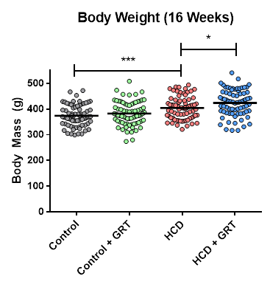
Body Mass and Intraperitoneal Fat
Notes:
The result of increased unhealthy food intake *CLICK* equated not only in a higher body mass for both the HCD and HCD with GRT animals, but also led to a considerable *CLICK* increase in intraperitoneal fat mass, or fat around the waste which is an independent indicator of cardiovascular risk.

Slide 44
Oral Glucose Tolerance Test
Notes:
Next, oral glucose tolerance tests on fasted rats showed that control groups, with or without GRT had a significantly lower fasting blood glucose and tolerated glucose better compared to the HCD counterparts. Furthermore, taking into account that these rats are only the equivalent of about 12, 13 years old in human years, the severity of this profile is expected to increase as these rats get older. Unfortunately, GRT supplementation had no significant effect on the blood glucose tolerance curve in such young rats.

Slide 45
Non-Fasting Blood Glucose
Notes:
Real-time non-fasting blood glucose levels, taken just prior to dissection of the rats, were also elevated in HCD groups compared to control groups.

Slide 46
Coronary Output = Aortic Output + Coronary Flow
Notes:
Moving onto the functional heart results: CARDIAC OUTPUT, representing the strength at which the heart pumps blood through itself and through the body was *CLICK* significantly worse for HCD groups compared to controls pre and post ischemia, and GRT treatment significantly improved coronary output pre and post ischemia. Even more curious, *CLICK* GRT supplementation in HCD groups completely restored the %coronary output recovery to that of control groups.

Slide 47
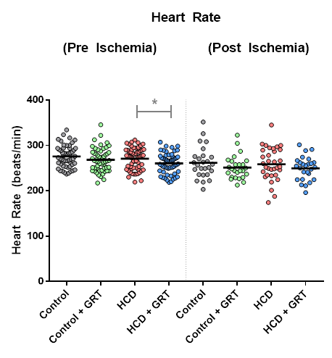
Heart Rate
Notes:
Heart rate *CLICK* was fairly similar between all treatment groups, with only GRT co-treated HCD animals showing a significant decrease pre-ischemia, however whether this is energy conservation or detrimental still needs further investigation.

Slide 48
Total Work
Notes:
Combining these findings with the systolic pressure obtained from these hearts, the Total Work parameter was *CLICK* significantly lower in HCD groups compared to controls, however GRT supplementation was able to improve work loading, and *CLICK* even restore %recovery in HCD groups to levels similar to GRT treated controls. This indicates that GRT supplementation is able to reverse negative outcomes induced by cardiometabolic risk factors pertaining to heart function and heart recovery post ischemia.

Slide 49

CONTROL
CONTROL+GRT
HCD
HCD+GRT
Notes:
We also had a closer look *CLICK* at GRT’s ability to protect the heart from ischemic damage by staining for viable tissue after ischemia.

Slide 50

CONTROL
CONTROL+GRT
HCD
HCD+GRT
Notes:
We also had a closer look *CLICK* at GRT’s ability to protect the heart from ischemic damage by staining for viable tissue after ischemia.

Slide 51

Infarct Size
Notes:
Viable tissue *CLICK* was consistently between 40-60%, with some outlying occurring in the HCD groups which had the most severe damage profile. *CLICK* Non-viable tissue was also highest in the HCD group, with GRT treatment reversing the damage incurred, and this was also evident *CLICK* from the infarct size (a measure of dead tissue compared to the area at risk, or the white tissue compared to the red tissue in the image above).

Slide 52

Results Continued
2
Notes:
Lastly, we were interested in a broad spectrum analysis of various cellular signalling intermediates pertaining to cardioprotection, including the Ras–MAPK signaling pathway such as p38, ERK1/2 and JNK, which are precursors of cell stress signaling; and intermediates in the PI3K–Akt–eNOS pathway, which results in metabolic modulation and cardiovascular protection.

Slide 53
Notes:
As this contains a lot of result discussion and I unfortunately do not have time to communicate all the results I will just swipe through and try to mention some observations made. Firstly, looking at P38, considered to be a stress signal, we note a *CLICK* gradual increase in phosphorylated P38, which could be a sign that hearts are being preconditioned to a subsequent ischemic insult.

Slide 54
Notes:
Erk, which acts as an important cell signalling switch in response to stress was significantly *CLICK* less phosphorylated post-ischemia in HCD with GRT treated rats compared to untreated HCD. This in turn can also indicate less stress post ischemia than experienced by HCD hearts.

Slide 55
Notes:
Likewise, stress-activated protein kinase, or JNK phosphorylation was also significantly *CLICK* reduced early into reperfusion in HCD with GRT compared to untreated HCD furthermore supporting the notion that GRT significantly reduced heart stress in high caloric diet rats.

Slide 56
Notes:
Glycogen synthase kinase 3b, important in regulating glucose homeostasis, was significantly reduced in HCD rats compared to controls, but following the present analysis not too phased by GRT supplementation.

Slide 57
Notes:
And finally, PKB, an important pro-survival kinase had a significantly *CLICK* higher content in GRT treated HCD post ischemia which could act as a cardioprotective impulse against reperfusion injury.

Slide 58
Summary of Results to DATE
High-caloric diet vs. control
↑ 25% Food intake and ↓ 35% Water consumption
↑ 10% Body weight, ↑ 60% Visceral adiposity
↓ 10% Coronary Output and Total Work after Ischemia
Afriplex Green Rooibos Extract
Pre-Ischemia
↑ 5% Total Work of Heart in Control and HCD
Post-ischemia
↑ 10% Aortic Output, Coronary Output and Total Work in HCD
Reversed Heart Damage of HCD
Infarct Size
↓ 20% Infarct Size in HCD
Cell Signalling
GRT supplementation potentially acts as a preconditioning agent improving resilience to reperfusion injury
Notes:
So, in summary of the results: *CLICK* The high-caloric diet increased food intake, decreased water consumption, leading to an increase in body weight and visceral adiposity. This resulted in decreased Heart recovery after ischemia.
*CLICK* Afriplex GRT supplementation for 6 weeks showed an improvement in heart function before ischemia in both control and HCD, and *CLICK* improved heart function and heart recovery after ischemia in rats susceptible for cardiovascular disease.
GRT also significantly *CLICK* reversed ischemic damage induced by cardiometabolic risk factors in a young rat model susceptible for cardiovascular disease.
Western blot analysis for cellular signalling *CLICK* involved in survival and cardioprotection indicate GRT supplementation potentially acts as a preconditioning agent improving resilience to reperfusion injury.

Slide 59
Future Work
Rooibos known to have cardioprotective properties
But How?
Normal vs Cardio-susceptible Model
Significantly elaborate on our current understanding of Rooibos supplementation benefits
Mitochondrial Bioenergetics
Notes:
So in conclusion: Rooibos is known to have cardioprotective properties – it has been shown in animals previously, and multiple daily servings of Rooibos tea can significantly reduce cardiovascular risk. However, the question of *CLICK* How still lingers. Especially regarding deeper cellular mechanics, the explanations are still lacking. This study offered the opportunity to compare normal *CLICK* physiological conditions with a cardiovascular at-risk profile on a large scale rat population, making it *CLICK* easier to observe the cardioprotective effects of high doses of Rooibos supplementation.
*CLICK* For the final part of my PhD we are investigating the role of GRT supplementation on mitochondrial bioenergetics after ischemia and how this potentially resulted in improving cardioprotection in these animals.

Slide 60
Take-Home Message
Sugar Bad for the Heart
Rooibos Good for the Heart
“Coffee break? Make it a Rooibos, please.”
Notes:
If asked what is my take-home message from doing this study it would be two-fold:
*CLICK* Firstly, sugar is really bad for the heart. Not only does it result in declining function and poor recovery post-ischemia, but its ability to incur irreversible damage would make me think twice before overindulging in sweet treats.
And secondly, I believe *CLICK* Rooibos has a future in primary health care. My reasoning is that it is a harsh plant to master – the conditions in which it is cultivated alone can be brutal, and somehow this results in unique polyphenols capable of scavenging stress brought upon by increased risk from our modern lifestyles. Therefore, *CLICK* if you had to snack on something… I’d say, rather make it a cup of rooibos.

Slide 61
Notes:
In closing, I will leave you with this quote, which is a common reminder that we are all biologically and spiritually the same. Thank God for that :)

Slide 62

Notes:
In closing, I will leave you with this quote, which is a common reminder that we are all biologically and spiritually the same. Thank God for that :)

Slide 63
Thank You
All Feedback Welcome!
Notes:
And Thank You for listening.

Slide 64




Notes:
I *CLICKS* would just like to give *CLICK* compliments to Charles Stirton for all of these Rooibos production photos. It made the design of this presentation a lot easier.

